Slide 1
Forest Cover Type Prediction
A Machine Learning Exercise by Rahul Adwani

Slide 2
Business Objective
Building a system which can predict the forest cover type based on cartographic parameters as captured via Satellite and a Spectrometer.
This system can be very useful for geographic mapping in research, forest protection, wildlife protection, and other important areas

Slide 3


Agenda
Understanding the Data
Getting Data ready for ML
Applying ML Algorithms
Evaluating Models
References

Slide 4
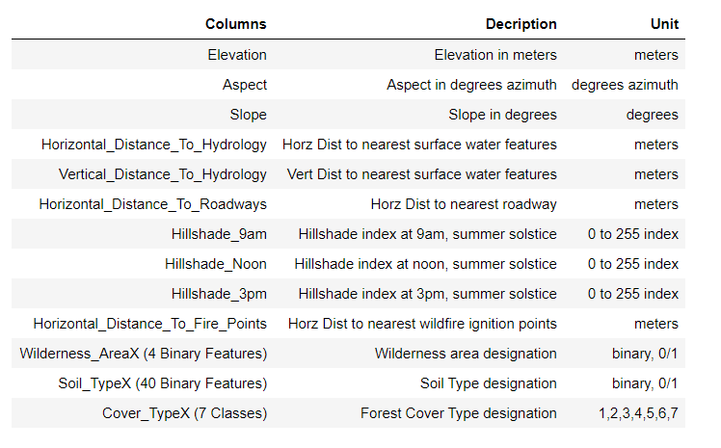
Understanding the Data
Feature Types
Distance from nearest mapped bodies (water, road, fire point)
Intensity of the shade received from hill under the Sun at 9AM, Noon and 3PM
Type of Soil - 40 Different Combinations of Soil Family & Ground Type
Wilderness Area Class - 4 Different Types of Areas
Cover Types - 7 Different Cover Types
Data Form
Soil Type & Wilderness Area - Binary Encoded
Cover Type - Label Encoded
Rest of Features - Actual Values
Data Counts
Rows - 15120, Columns - 56

Slide 5
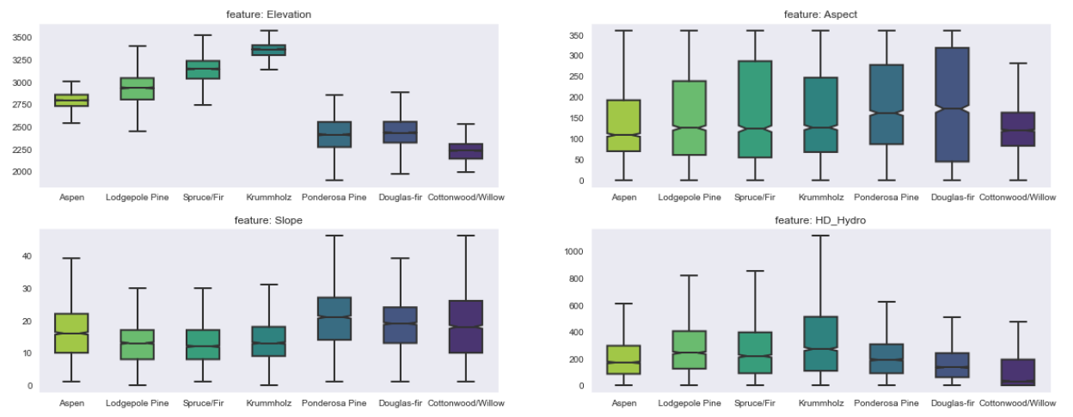
Understanding the Data - Actual Value Features Vs Cover Types

Slide 6
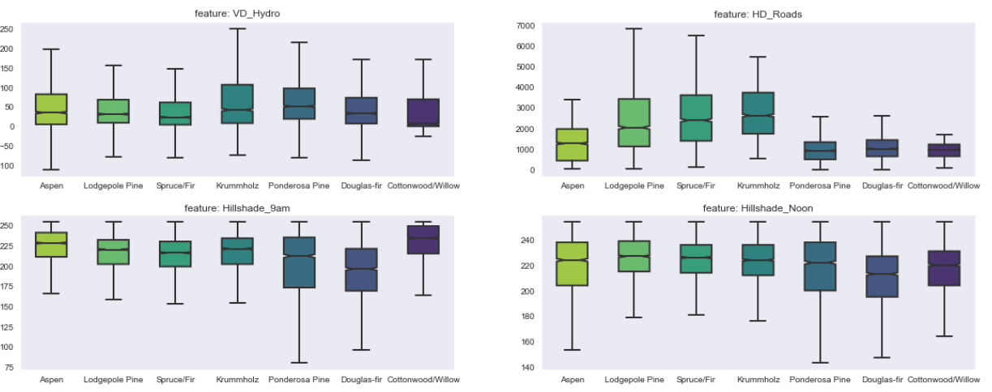
Understanding the Data - Actual Value Features Vs Cover Types

Slide 7
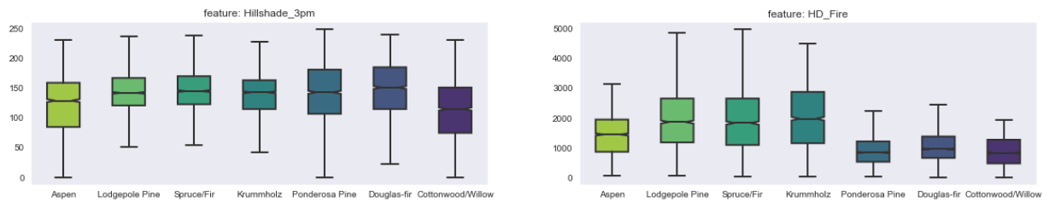
Understanding the Data - Actual Value Features Vs Cover Types

Slide 8
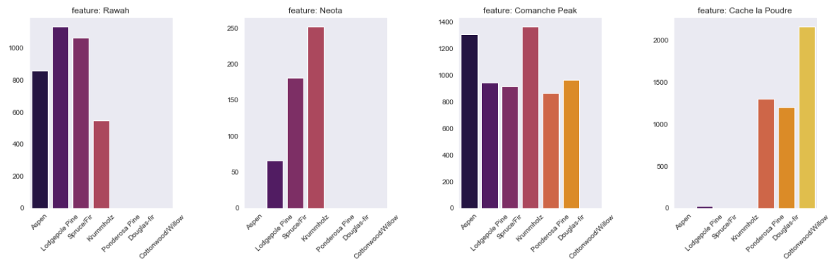
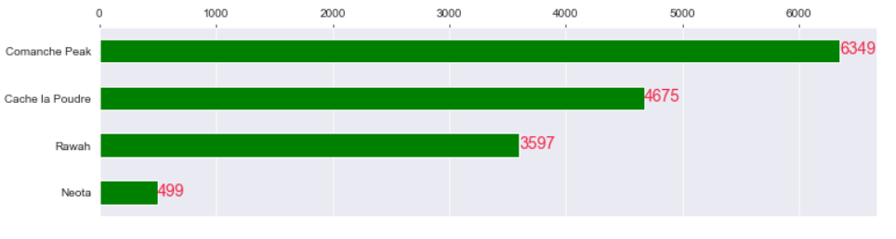
Understanding the Data - Wilderness Area Types Vs Cover Types

Slide 9
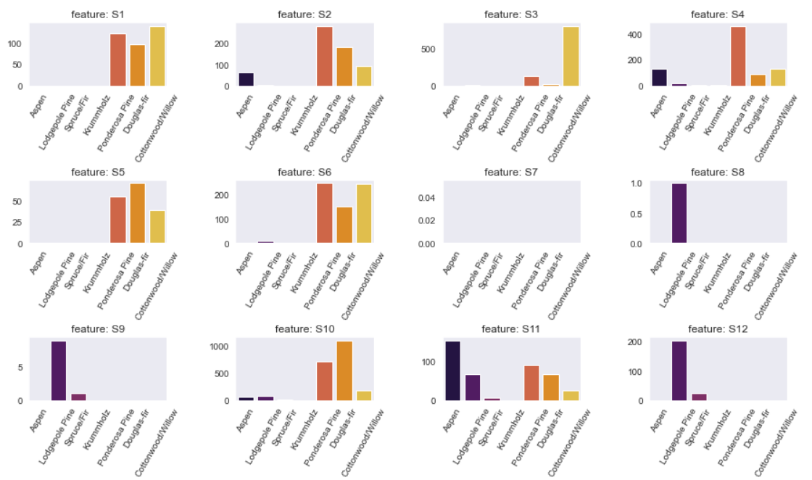
Understanding the Data - Soil Types Vs Cover Types

Slide 10
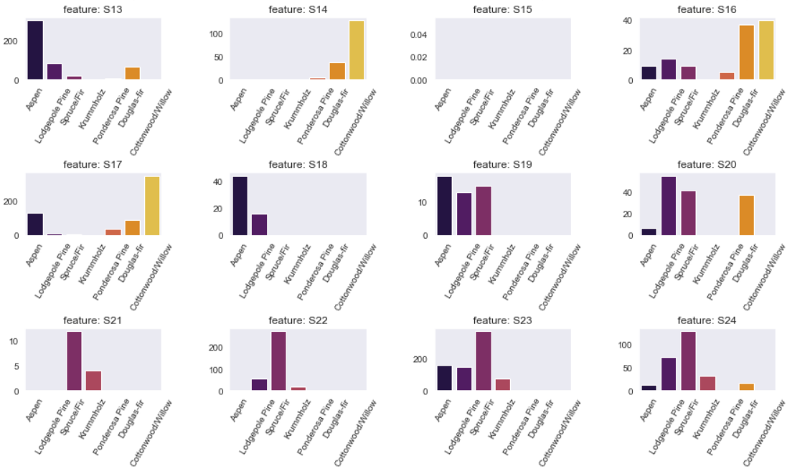
Understanding the Data - Soil Types Vs Cover Types

Slide 11
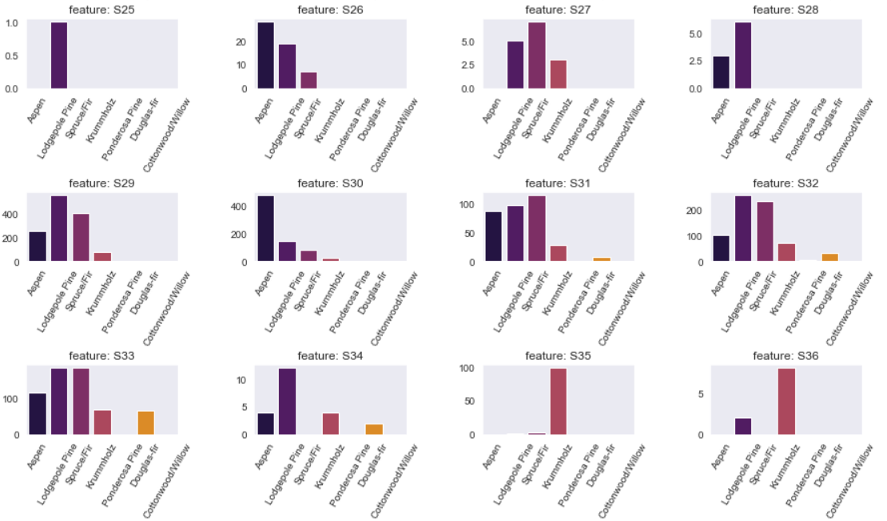
Understanding the Data - Soil Types Vs Cover Types

Slide 12
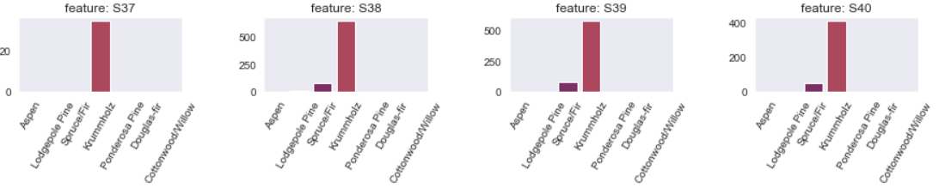
Understanding the Data - Soil Types Vs Cover Types

Slide 13
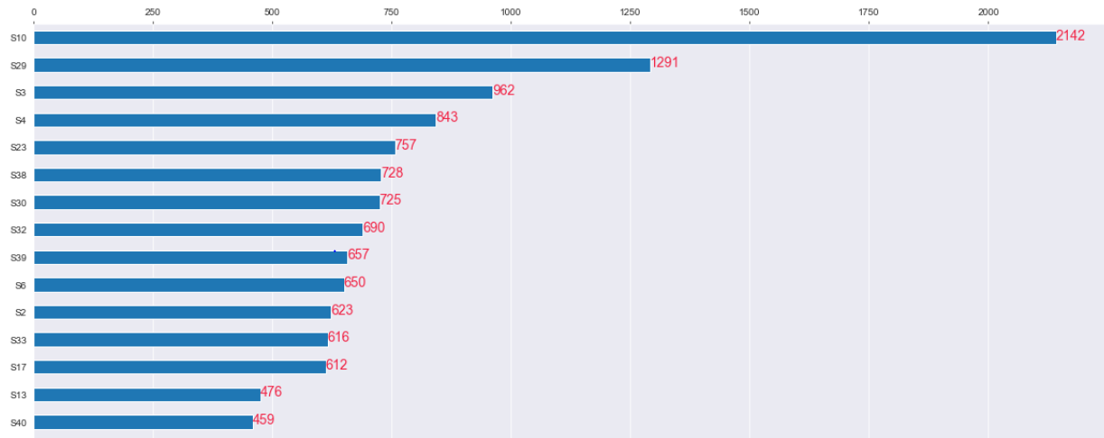
Understanding the Data - Soil Types Vs Cover Types

Slide 14
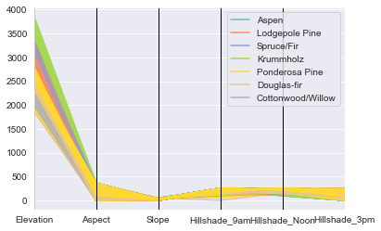
Understanding the Data - Elevation, Aspect, Slope, Hillshade Vs Cover Types

Slide 15
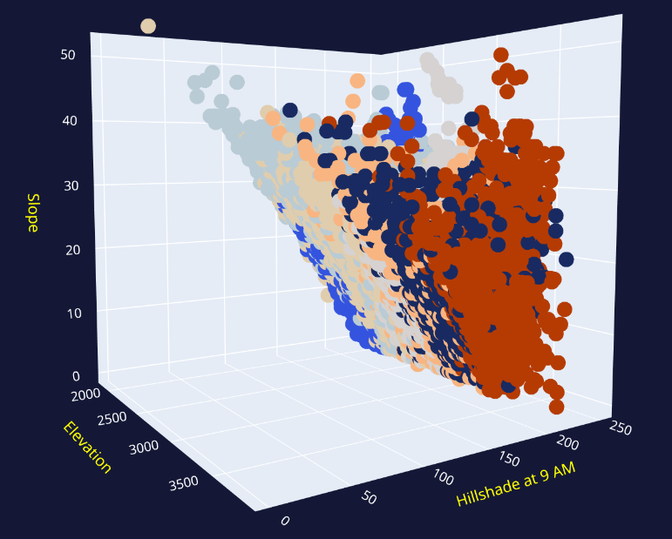
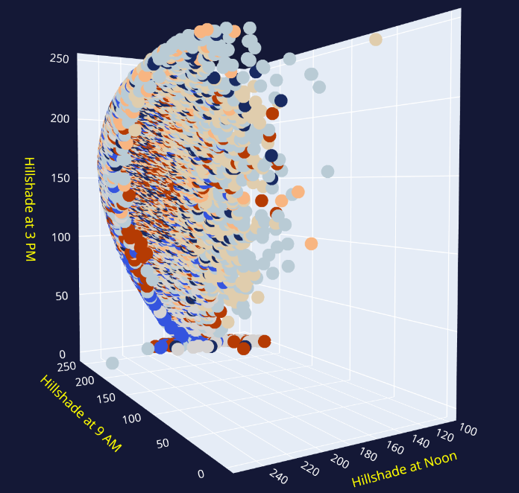
Understanding the Data - Elevation and Hillshade Vs Cover Types

Slide 16
Getting Data ready for ML - Data Preprocessing
Handling Missing & Erroneous Values
Vertical Distance to Hydrology (Negative Values)
Aspect (0 degrees and 360 degrees)
Feature Engineering
Units - Aspectx2 & Slope
Correlation Based - Distance to Hydrology
Reading Between the Lines - Hillshade
Others - Ground Type
Encoding
One Hot Encoding - Categorical Features
Label Encoding - Label
Handling Label Class Imbalance
No Imbalance observed across the label classes
Handling Outliers in Features
Isolation Forest - Minimal Impact (16 Cases Only)
Data Scaling
Standard Scaling
MinMax Scaling
Robust Scaling
Feature Selection
Principal Components Analysis
Select KBest using ANOVA Test

Slide 17
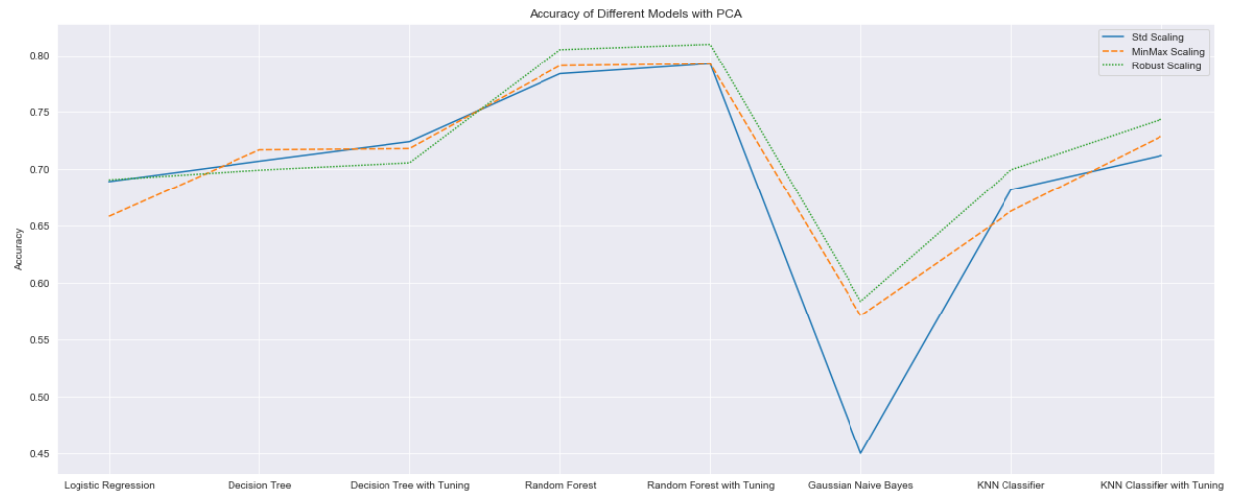
Evaluating the Model

Slide 18
Evaluating the Model

Slide 19
Evaluating the Model
Selected Algorithm - Random Forest with Robust Scaling and Feature Selected using KBest - ANOVA Test Algorithms
Accuracy: 86.11%

Slide 20
References
http://people.csail.mit.edu/bkph/papers/Hill-Shading.pdf
https://scientiaplusconscientia.wordpress.com/2014/12/16/hillshading-digital-elevation-model/
https://stackoverflow.com/
https://www.insaid.co/

Slide 21
THANK YOU!

